Slide 1
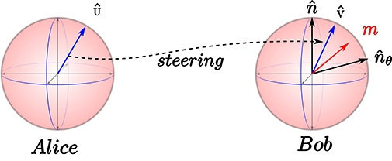
Improvements on Active Quantum Steering
Yiyang Jiang, Tsinghua University
Xinan Wu, Peking University
Yunlong Wu, Shanxi University
Notes:
NOTE:
To change the image on this slide, select the picture and delete it. Then click the Pictures icon in the placeholder to insert your own image.

Slide 2
Contents
1
Background
2
Motivation
3
Method &
Timeline
4
Expected
Results

Slide 3
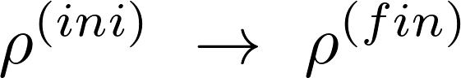
Background: Quantum Steering
Goal:
Traditional Methods & Their Drawbacks:
1. Projective Measurement (Probablistic)
2. Thermal Contact (Low T Needed)
3. Perturbation (Precise Interval Control Needed)
Roy, Sthitadhi, et al. Physical Review Research 2.3 (2020): 033347.

Slide 4
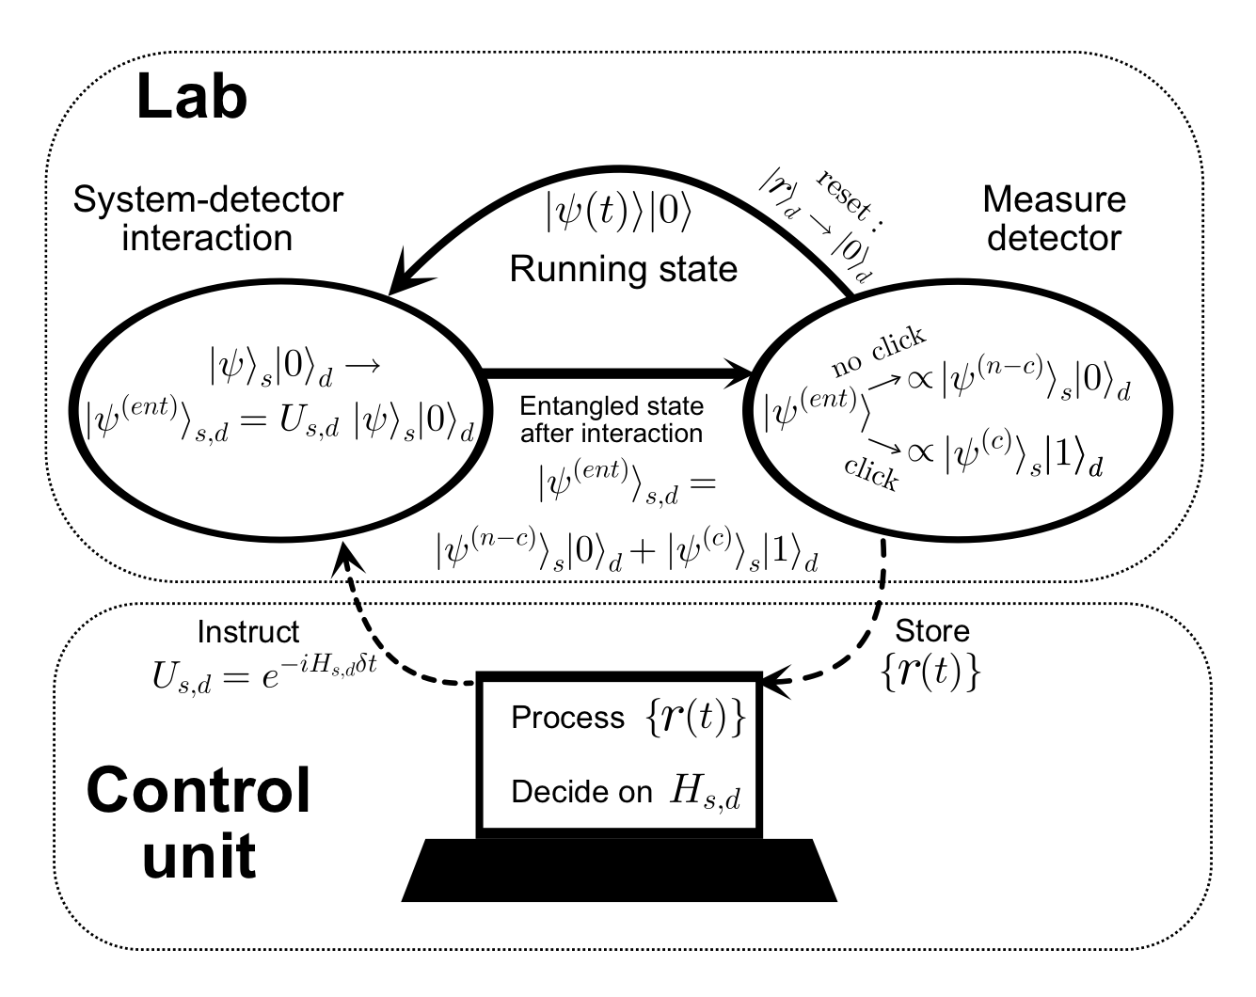
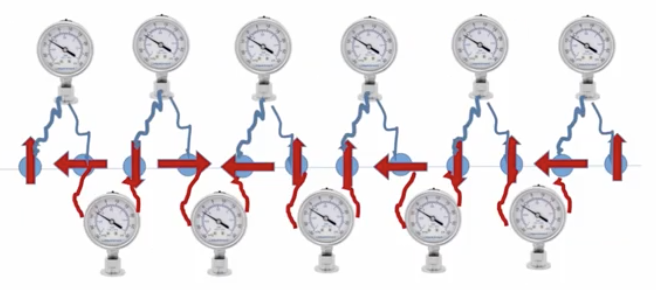
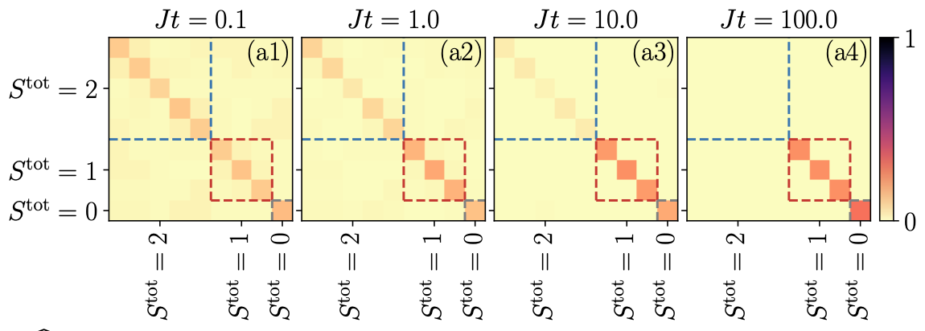
Background: Quantum Steering
Active Quantum Steering (AQS)
Passive Quantum Steering (PQS)
Herasymenko, et al.
arXiv preprint arXiv:2111.09306 (2021)
Roy, Sthitadhi, et al.
Physical Review Research 2.3 (2020): 033347.

Slide 5
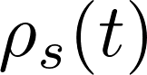
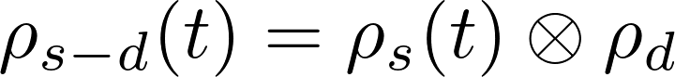
Background: Schematic of PQS
s: system
d: detector
Trace out detector (Decouple)
Couple to detector
Unitary evolution
Roy, Sthitadhi, et al. Physical Review Research 2.3 (2020): 033347.

Slide 6
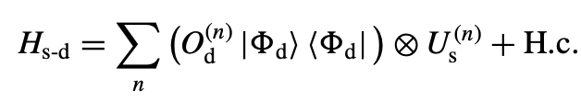
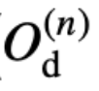
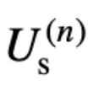
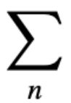
Background: Schematic of PQS
acts on the detector Hilbert space, flipping the detector qubit
acts on the system Hilbert space,
steering the system towards the target state
sums over states orthogonal to the target state,
every element is a Hilbert space navigating tool in a “kit”
Roy, Sthitadhi, et al. Physical Review Research 2.3 (2020): 033347.

Slide 7
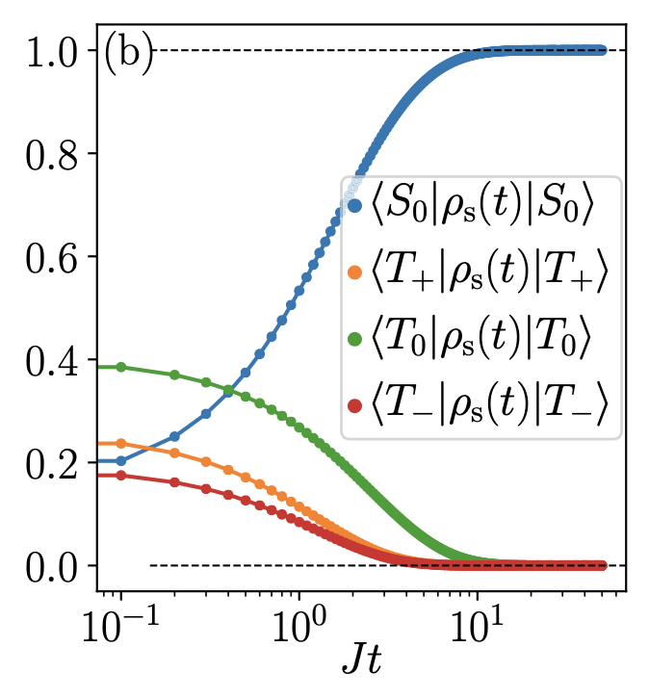
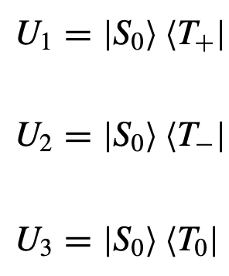
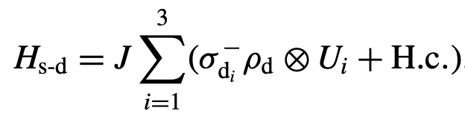
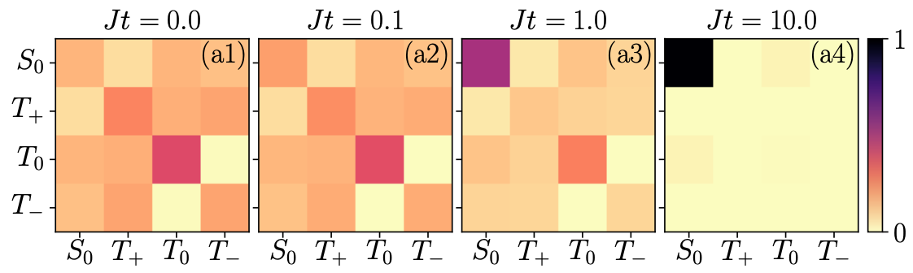
Background: Example of PQS
e.g. Spin-1/2 Pair towards Singlet State
Roy, Sthitadhi, et al. Physical Review Research 2.3 (2020): 033347.

Slide 8
Background: Example of PQS
e.g. Spin-1/2 Pair towards Singlet State
Navigating Tools
in Hilbert Space
Roy, Sthitadhi, et al. Physical Review Research 2.3 (2020): 033347.

Slide 9

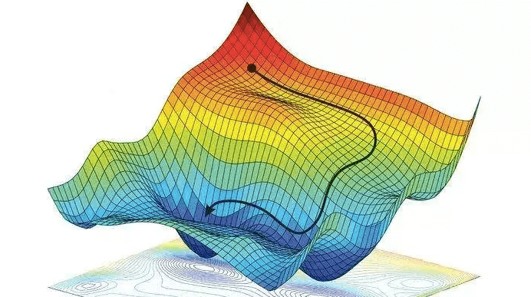
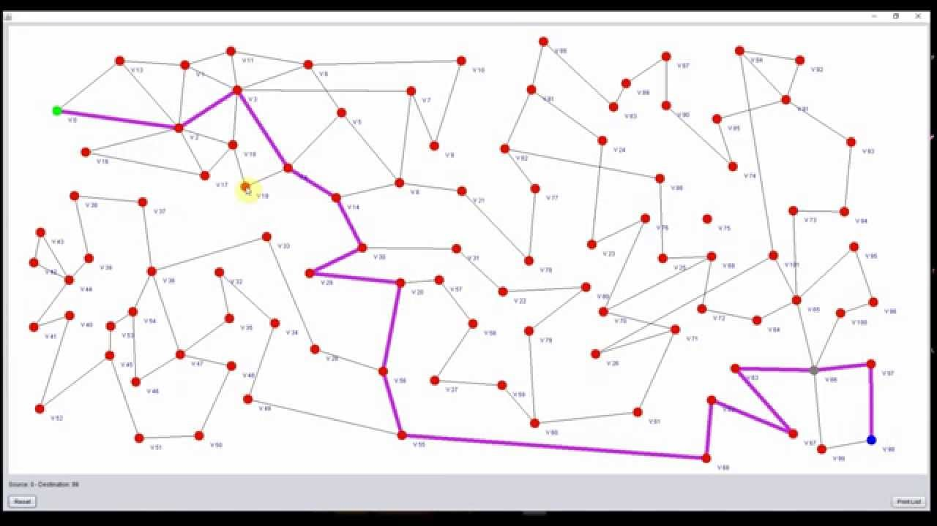
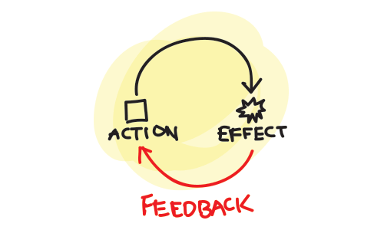
Background: 2 Methods in AQS
AQS
What if we read out
and steering using feedback?
Greedy Orienteering Policy (GOP)
Herasymenko, et al. arXiv preprint arXiv:2111.09306 (2021)
Quantum State Machine (QSM)

Slide 10
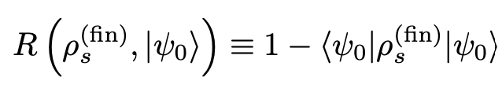
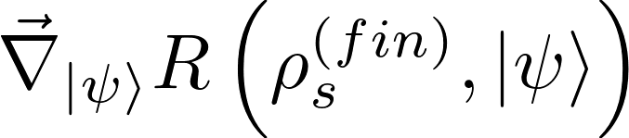
Background: GOP Based on Cost Function
“Landscape” of Cost Function
Searching Best Navigating Tool
Cost Function
GOP = “Steepest Descent”
Herasymenko, et al. arXiv preprint arXiv:2111.09306 (2021)

Slide 11
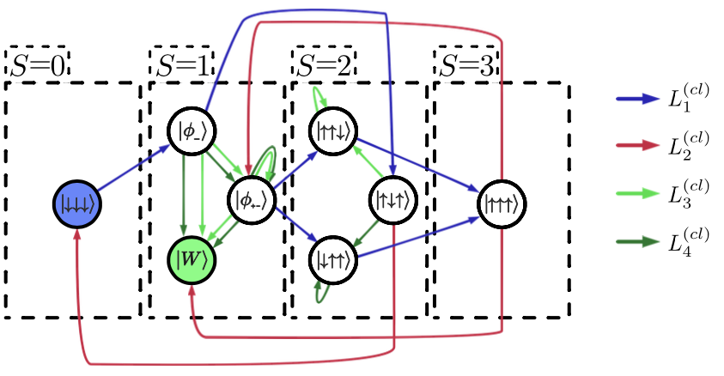
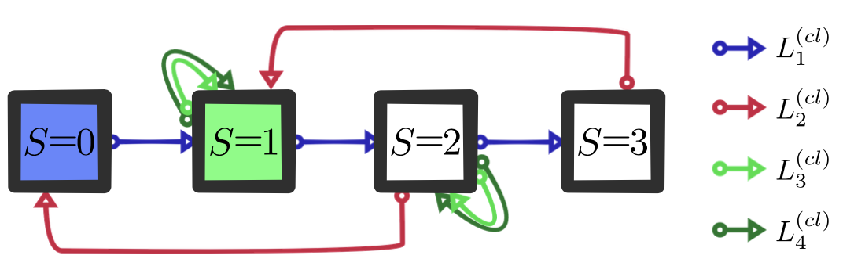
Background: QSM & Shortest Path
Analogy to Shortest Path Problem
in Graph Analysis
Quantum State Machine (QSM)
Herasymenko, et al. arXiv preprint arXiv:2111.09306 (2021)

Slide 12


Motivation: Potential Improvements?
Speedup of AQS?
More Error-Tolerant?

Slide 13
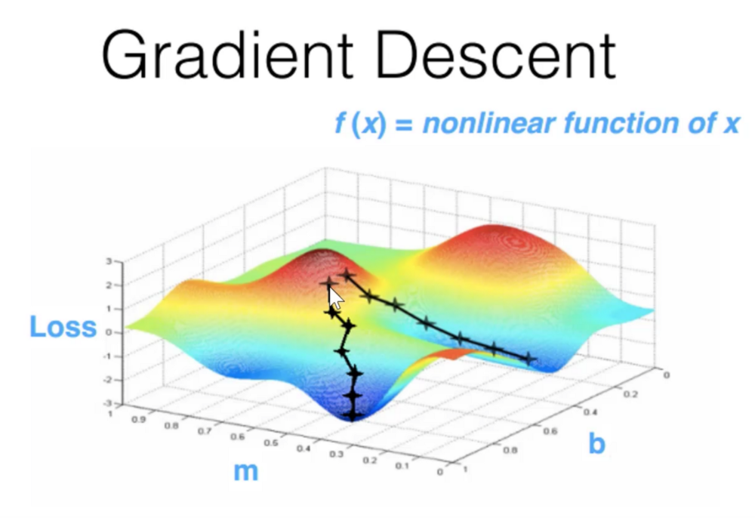
Motivation: Possible Improvements of GOP
Cost
Function
Local
Minimum
Global
Minimum
Potential Error in GOP
Single-step v.s. Multi-step Forecast
Cost Function Choosing
Herasymenko, et al. arXiv preprint arXiv:2111.09306 (2021)

Slide 14
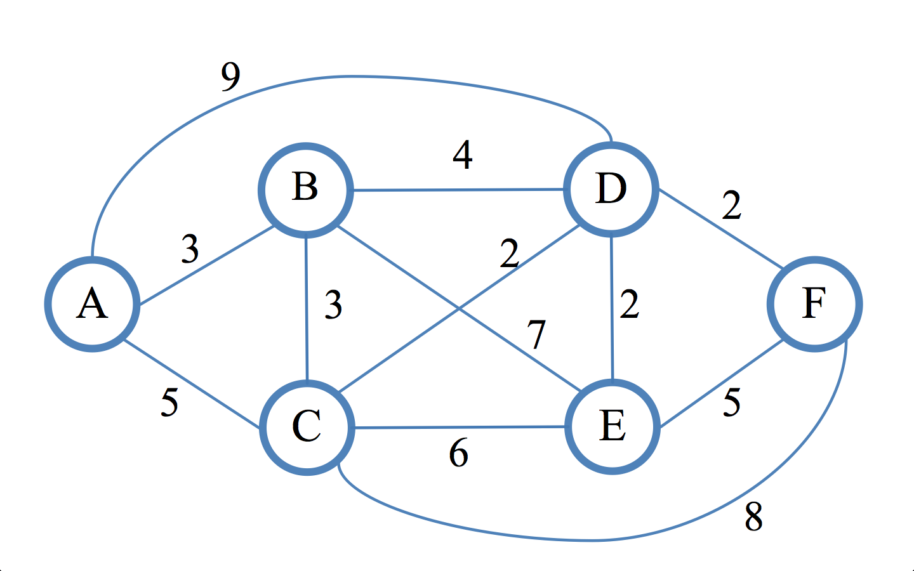
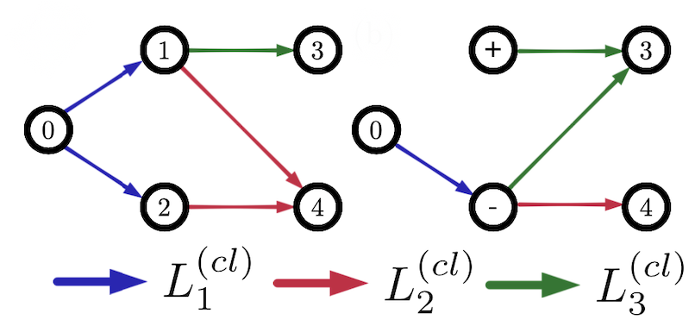
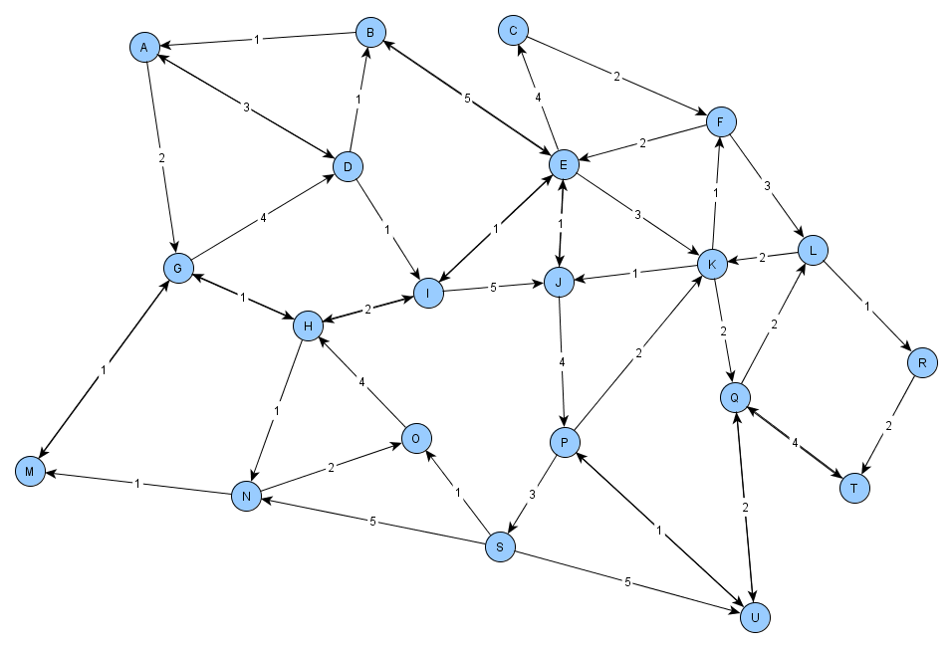
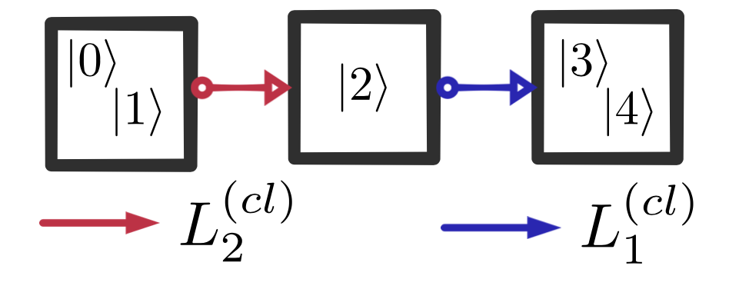
Motivation: Possible Improvements of QSM
Basis Choosing of QSM
Herasymenko, et al. arXiv preprint arXiv:2111.09306 (2021)

Slide 15
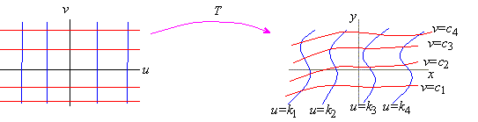

Research Goal: Improve AQS's Speed & Error-Tolerance
Clever Choice of Basis
Speedup of AQS
Multi-step Forecast Strategy
Improved Error-Tolerance

Slide 16
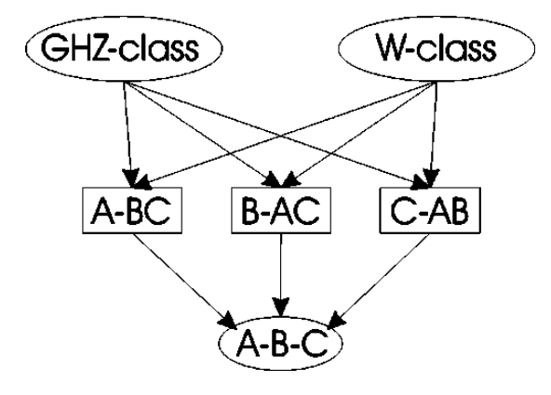
Research Plan
a. find many-body entangled states
b. Design passive and active QS methods (especially the improved active)
c. Do some numerical simulation and Compare the effects of various steering protocols, analyze accordingly
tripartite pure states.
W. Du¨r, et al. PhysRevA.62.062314

Slide 17
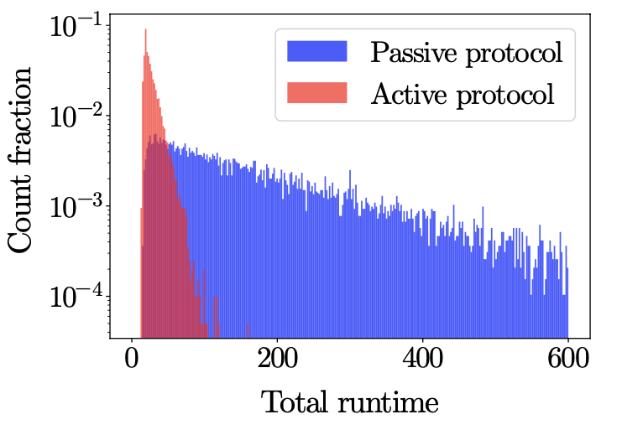



Method: Numerical Simulation
Test the preliminary quantum steering protocol
Compare the effect of different cost function in GOP
Compare the effect of different basis choosing in QSM
Numerical Simulation
Coding Software
Roy, Sthitadhi, et al. Physical Review Research 2.3 (2020): 033347.

Slide 18
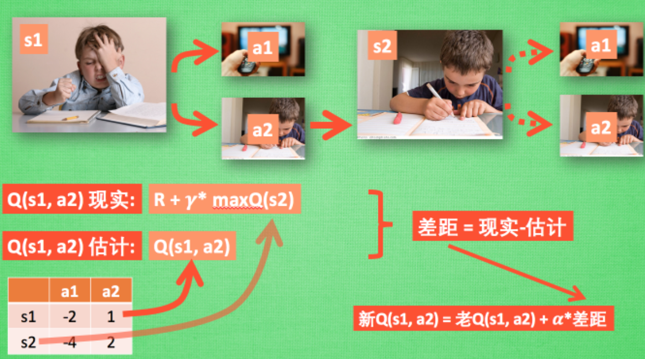
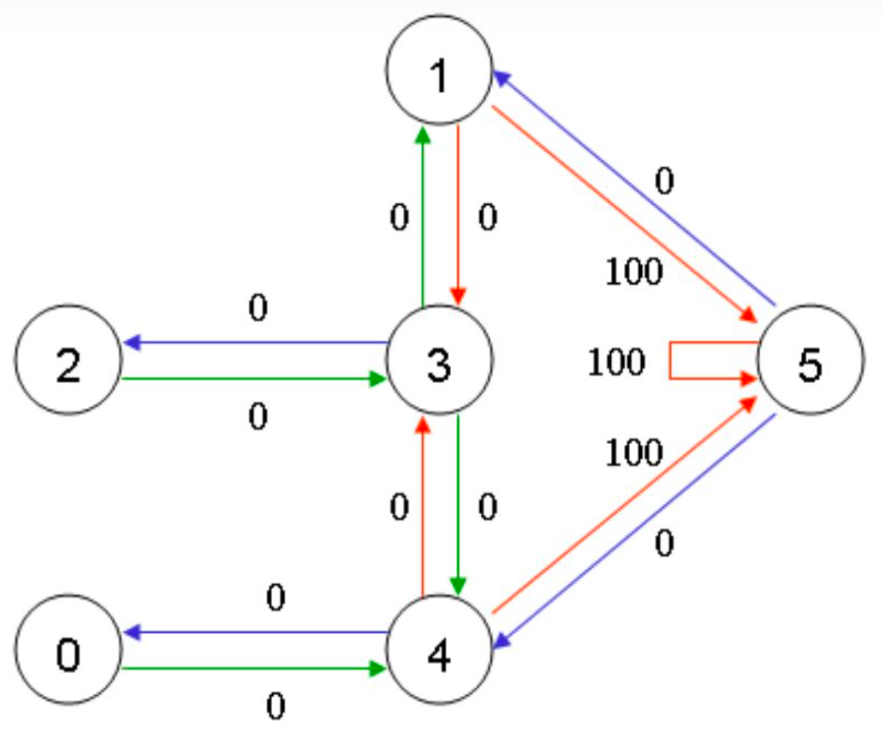
Method: Machine Learning
Find the best base selection and determine the best number of steps to take in the Greedy Orienteering Policy
Q-Learing
SARSA
C. Watkins, Learning from delayed rewards, Robotics Autonomous Systems (1989).
G. A. Rummery and M. Niranjan, On-line q-learning usingconnectionist systems, Technical Report (1994)

Slide 19
Timeline & Personnel
Personnel
02/10-03/21: Literature research and talk with Yuval Gefen.
03/22-03/31: Find target state and propose remitive QS method.
04/01-04/10: Numerical simulations of premitive QS method and do some preliminary
04/10-04/30: Discuss how
05/01-05/31: As well as improving the speed of the steering, we will improve the fault tolerance of the steering by improving some problems or errors in the Greedy Orienteering Policy.
Yiyang Jiang : Literature Research
Xinan Wu : Numerical Simulation
Yunlong Wu : Machine Learning
Process
Daily communication on process
Make adjustments as needed
Ask with Prof. Yuval Gefen timely

Slide 20
Expected Results
Improve the active quantum steering speed and fault tolerance rate
Provide quantum steering strategy for preparing more complex entanglement states

Slide 21
Reference
Y. Herasymenko, I. Gornyi, and Y. Gefen, Measurementdriven navigation in many-body hilbert space: Activedecision steering, (2021).
E. SchroDinger, Die erfassung der quantengesetze durch kontinuierliche funktionen, 17, 486 (1929).
Brun and A. Todd, A simple model of quantum trajectories, American Journal of Physics 70, 719 (2001).
S. Roy, J. T. Chalker, I. V. Gornyi, and Y. Gefen, Measurement-induced steering of quantum systems, Physical Review Research 2 (2020).
S. Borah, B. Sarma, M. Kewming, G. J. Milburn, and J. Twamley, Measurement based feedback quantum control with deep reinforcement learning, (2021).
W. D¨ur, G. Vidal, and J. I. Cirac, Three qubits can be entangled in two inequivalent ways, (2000).
C. Watkins, Learning from delayed rewards, Robotics Autonomous Systems (1989).
G. A. Rummery and M. Niranjan, On-line q-learning using connectionist systems, Technical Report (1994).

